Slide 1
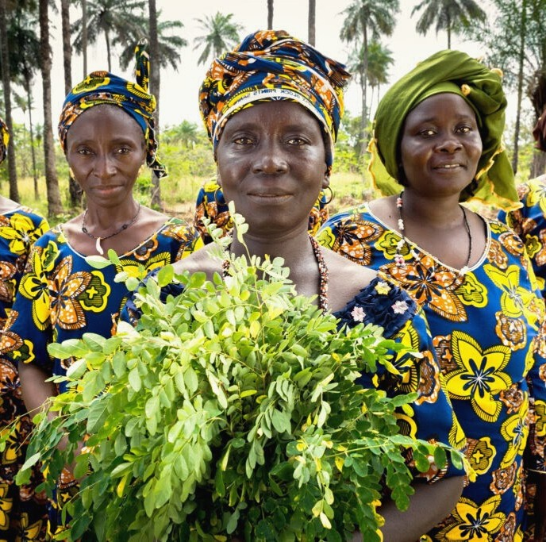

The Standard
Q U A N T I F Y I N G W O M E N ' S E M P O W E R M E N T

Slide 2

The First-Ever Standard to Measure and Monitize Women's Empowerment
The W+ Standard was founded in 2015 by WOCAN (Women Organizing for Change in Agriculture and Natural Resource Management) with 16 years of experience providing meaningful resources to over 1,500 members in 113 countries.
The W+ Standard is the first women-specific standard that measures women's empowerment in a transparent and quantifiable manner, gives a monetary value to results and creates a new channel to direct financial resources to women.

Slide 3
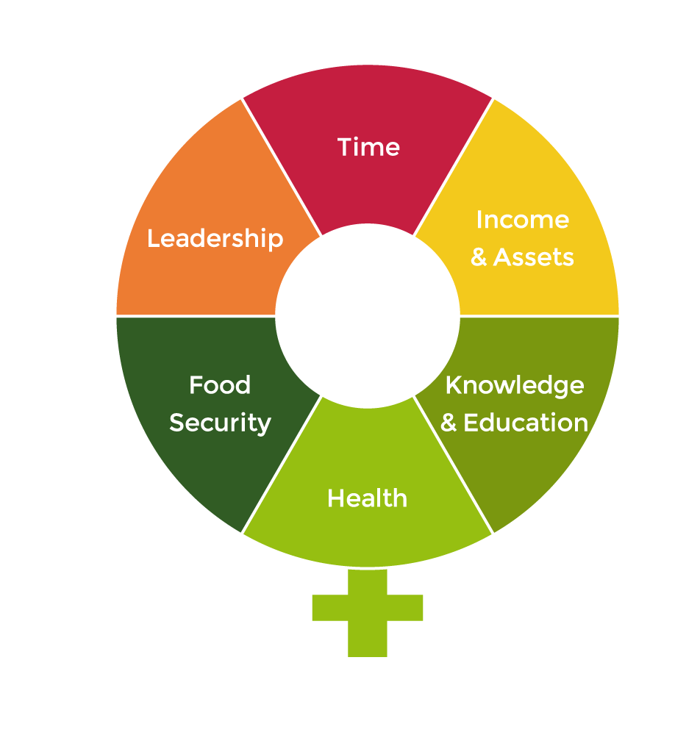
How Women Are Empowered
The W+ Standard measures six domains that are critical for women's empowerment:
Time, Income & Assets, Health, Leadership, Education & Knowledge and Food Security. These were determined together with rural women from Nepal and Kenya alongside gender experts. Methods were developed to measure and quantify progress for each of these domains.

Slide 4
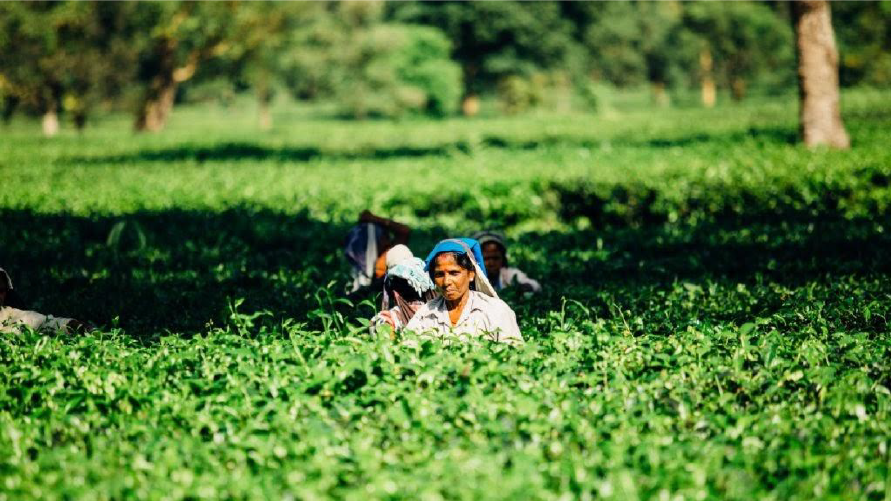
Women do 66% of the world's work
But earn only 10% of the world's income
Yet they reinvest 90% of their income into family and community
source: UNICEF, Gender Equality, 2007

Slide 5
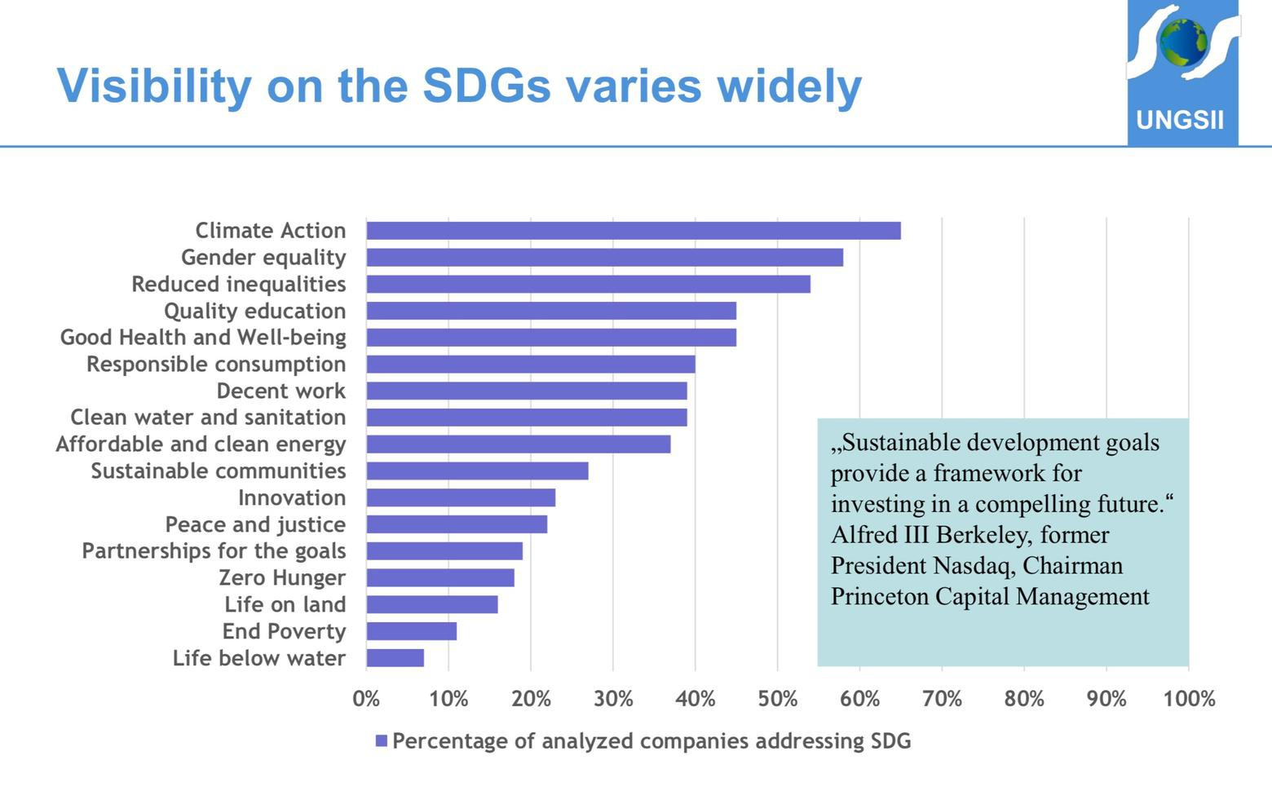

A recent report of the 100 largest companies with SDG commitments shows Climate Action and Gender Equality as their top priorities
Corporate demand for climate and gender focused projects is overwhelming
W+ labeled carbon projects provide corporates with a unique (and the only) opportunity to meet carbon AND gender goals through one quantified project
source: UNGSII, Sustainable Development Goals Commitment Report 100

Slide 6
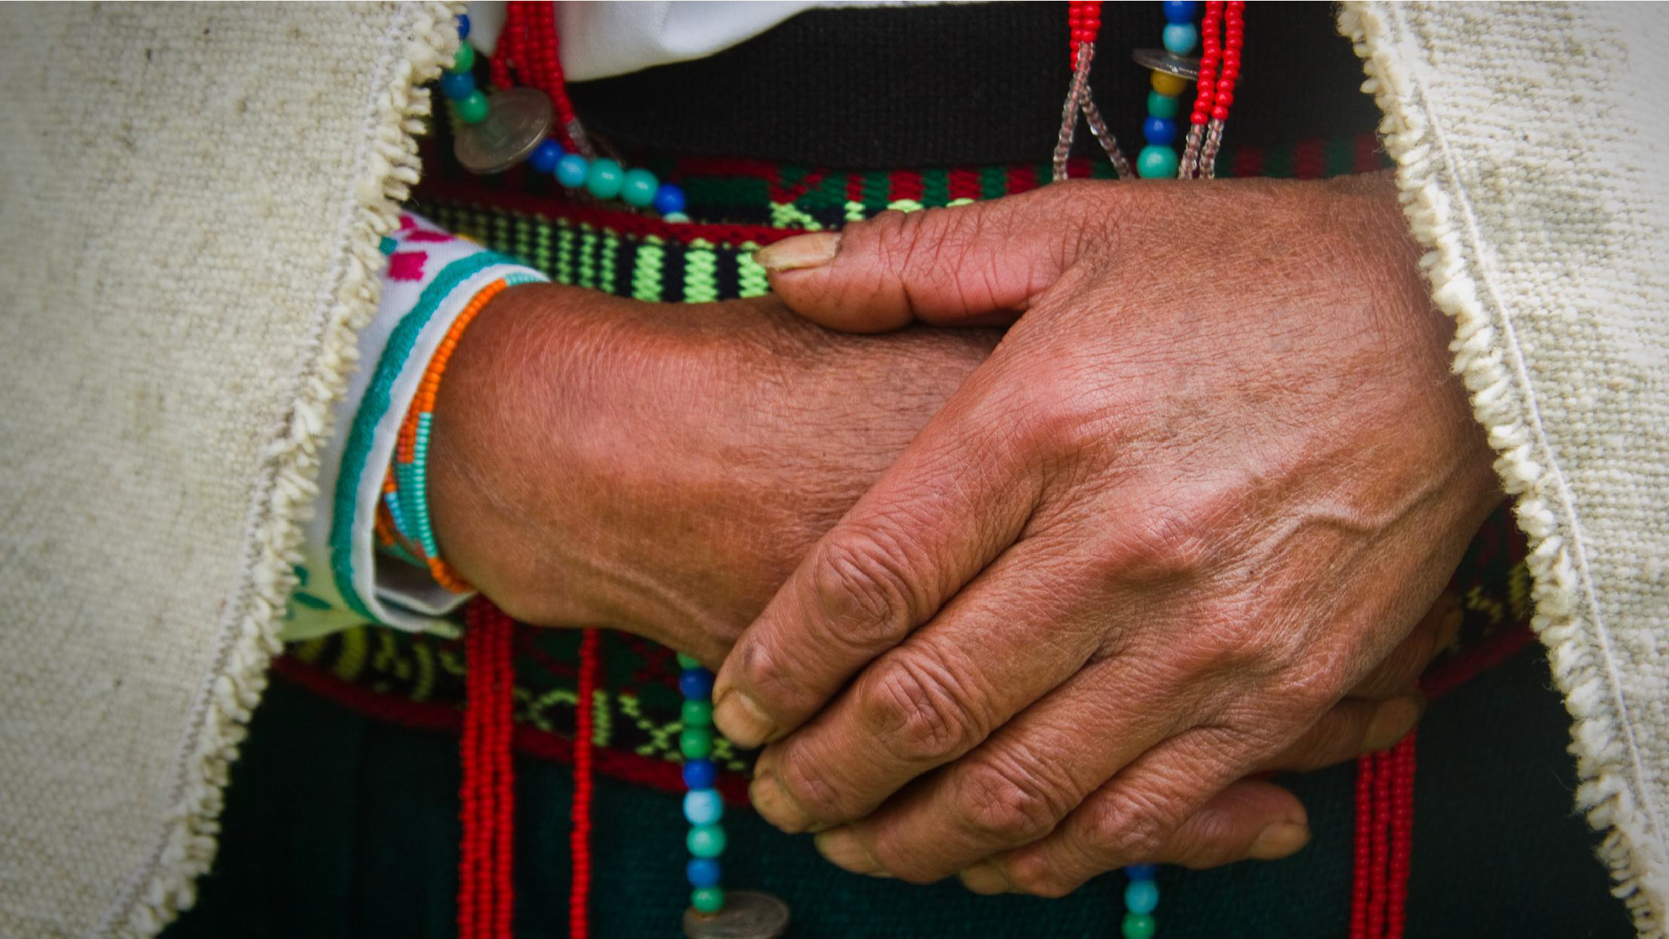
W+ is the only gender focused standard to be included in the Verified
Carbon Standard (VCS/ VERRA)
Making it efficient and cost effective for project developers to add the W+ Standard to their existing carbon projects

Slide 7
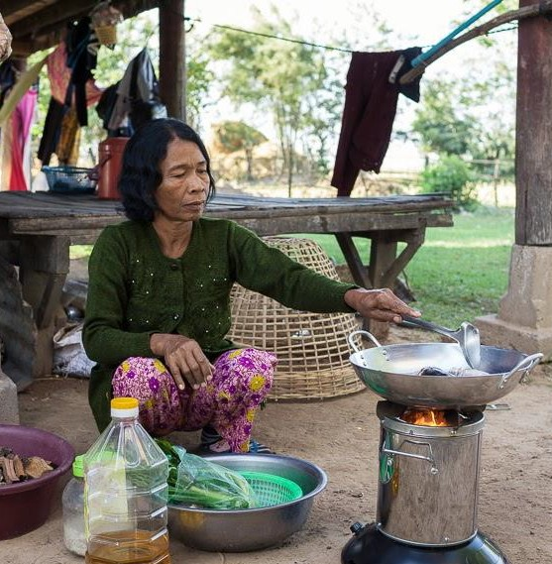
W+ Projects
Registered and Certified W+ Projects
HONDURAS INDONESIA MOROCCO NEPAL
SRI LANKA SOUTH AFRICA VIETNAM
14,575 women's lives have been improved as measured and verified by The W+ Standard

Slide 8


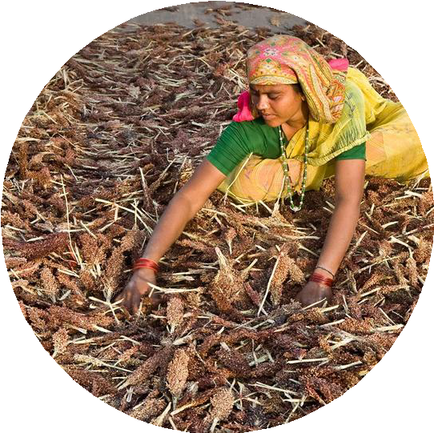


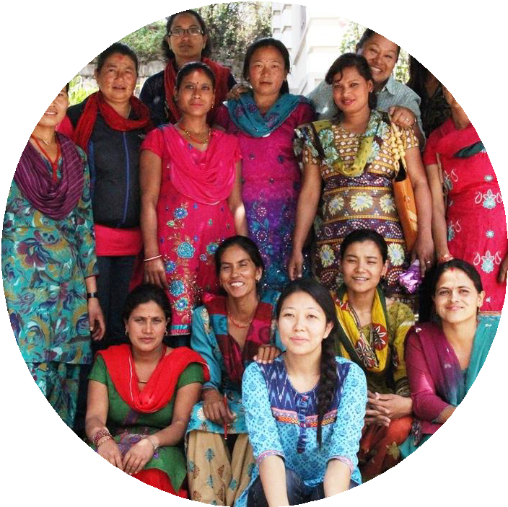

How the Standard Works
1. Project is registered & certified
Project activities in 1 or more of 6 domains are actively benefiting women
2. W+ units are sold to companies and other institutions
3. Women receive a minimum of 20% of the sale of W+ units, further providing benefits through a direct channel of income distributed by W+

Slide 9
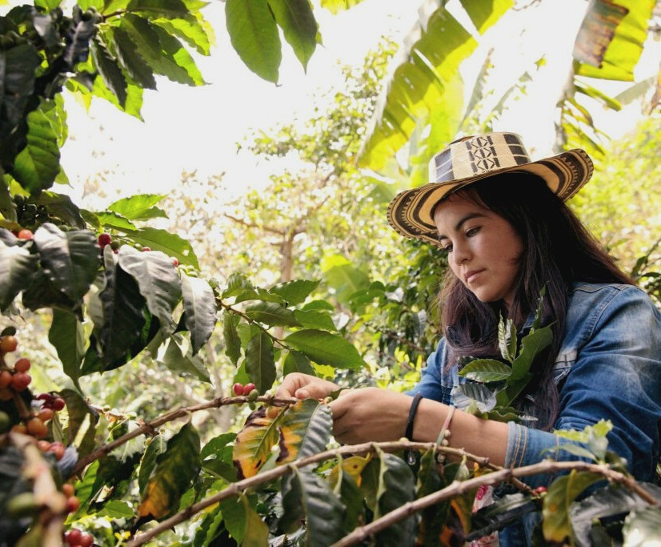
The W+ Standard is the only gender- focused standard that:
Received the UNFCC's Momentum for Change Award in 2016
Is included in the Verified Carbon Standard (VCS/VERRA)
Has been adopted by The World Bank and the Global Impact Investing Network (GIIN)
Quantifies commitments related to SDG #5

Slide 10
A unique opportunity for project developers to monetize women's empowerment activities through a proven standard

Slide 11
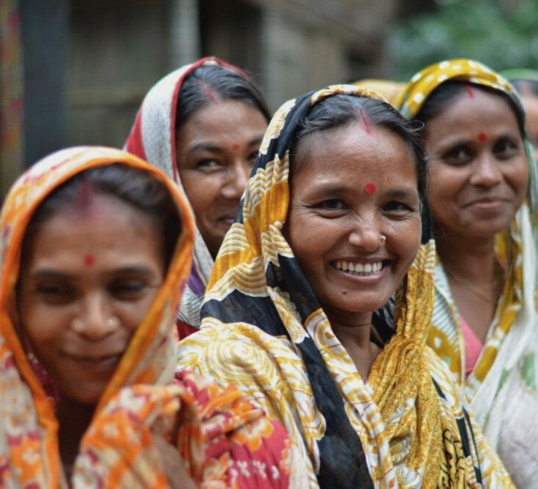
Thank You!
Get in touch with us
www.wplus.org coordinator@wplus.org

